Slide 1
Lecture 2019

Slide 2


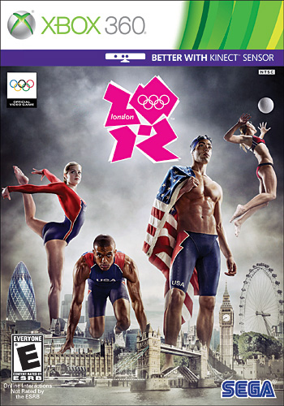

Who am I
Matt Dalby
XR Interaction Lead at Unity Technologies

Slide 3
The plan
Tracking Basics
Raycasts and Physics Layers
Selecting things with raycasts
Interaction
Teleportation

Slide 4
SPaces
A space is just an arbitrary mathematical concept.
We’ll be sticking to Cartesian coordinate systems in 3 dimensions
We use them to simplify things, and to compartmentalize problems
https://en.wikipedia.org/wiki/Three-dimensional_space
https://en.wikipedia.org/wiki/Cartesian_coordinate_system#Three_dimensions

Slide 5
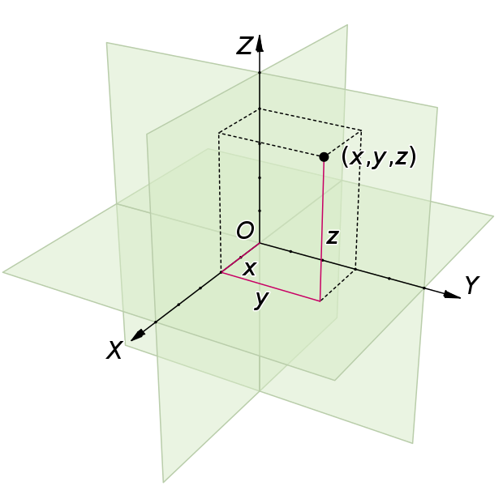
Cartesian spaces
https://en.wikipedia.org/wiki/Cartesian_coordinate_system

Slide 6
Session Space
XR Devices report Poses (rotation and position) in Session Space
Origin of session space is typically either
Where the device was at power up
On the floor in the center of the play area.
We use the terminology “Tracking Origin” to indicate where the Origin of session space is.
Device Tracking Origin
Floor Tracking Origin

Slide 7
Wait hang on, what about AR
There’s really three different cases
Local (Seated/Stationary style experiences)
Bounded (Roomscale style experiences)
Unbounded (AR Worldscale experiences)
These cases impact where Session Space will be relative to
Local = Device or Floor Tracking Origin (more likely device)
Bounded = Device or Floor Tracking Origin (more likely floor)
Unbounded = Anchor Tracking Origin
We’re really only concerned with Local and Bounded cases for VR.

Slide 8
Device Tracking Origin
0,0,0 in device space is “at the device” the device will report its position relative to this 0,0,0.
Common for seated/standing/stationary scenarios.
Common for mobile devices that don’t understand how far off the floor they are.
Eg: the position of a hololens when you turn it on is treat as 0,0,0 in device space.
Eg: the position of a phone when using mobile AR is usually 0,0,0 in device space (or session space).

Slide 9
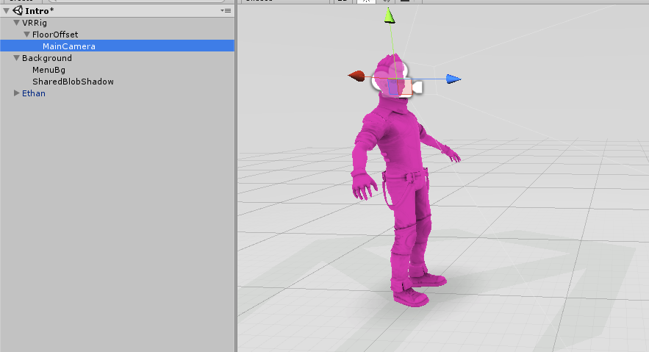
Device Tracking Origin

Slide 10
Floor Tracking origin
0,0,0 in device space is on the floor. The position of the device is treat as above the floor at the height of the user/wearer
Found in some roomscale scenarios
Eg: for OpenVR, the origin is the center of your play area.

Slide 11
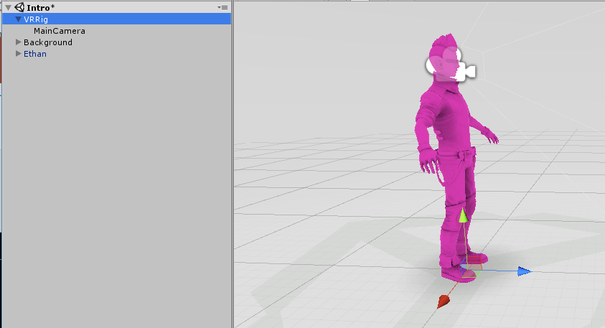
Floor Tracking Origin

Slide 12
Mapping between Device and Unity World Space
Unity treats 1 unit of world space to be 1m
Session space typically also treats 1 unit of space is equivalent to 1m
This is totally arbitrary and completely serendipitous
If the camera is at the origin of unity world space, both unity world space, and device space will be congruent.
Unity has “implicit” tracking, it will apply the HMD’s session space transform to the “Main Camera”.
We’ll be using the Tracked Pose Driver instead.

Slide 13
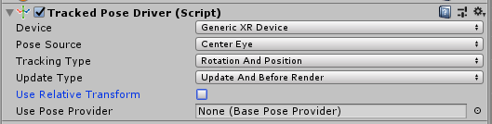
Tracked Pose Driver
Monobehaviour added in 2017.1
Makes a game object’s transform follow a Pose.
Eg: a headset, or a controller.
You can finally control a camera with your controller!*
*we don’t recommend this at all unless you want to make yourself sick

Slide 14
Tracked Pose Driver
If you attach the TPD to a camera, it will turn off the implicit camera control. Even if the TPD itself is turned off.
This can be handy if you want to finally control the camera in VR!
Although we advice caution, as its very easy to make people sick.
We’ll talk about user comfort in a bit
Can use the Tracked Pose Driver in “Use Reference Transform” mode to replicate the implicit camera control behavior.
But we really want to do away with implicit reference transforms.

Slide 15

Recommended Hierarchy
XR Rig (Game Object)
Camera Height (MonoBehaviour)
Floor Offset (Game Object)
Head (Game Object)
Camera (MonoBehaviour)
Tracked Pose Driver (MonoBehaviour)
Left Hand (Game Object)
Tracked Pose Driver (MonoBehaviour)
Right Hand (Game Object)
Tracked Pose Driver (MonoBehaviour)
XR Rig game object acts as the anchor for Session Space in Unity World Space.
XR Rig game object has the “camera height” script to handle the difference between Floor and Device tracking origins.
To move the player in world space. Move the XR Rig!
The Head / Left / Right hands all use a TPD set to not use a reference transform.

Slide 16
Wait, you said hands?
The implicit camera control system only kept a reference transform for cameras. It often meant that developers had to keep their own reference transforms for controllers, or were very confused when the controllers were at the origin of unity world space, and their head was where the camera started in the scene.
By putting the head and hands under an XR Rig we can move the entire player around without needing to worry about keeping reference transforms correct, or adding back in the player height.

Slide 17
Raycasts
Raycasts, as the name suggests, cast a ray from a point in space in the direction requested.
Physics.Raycast returns the first object it hits, Physics.RaycastAll will return all the things hit by the ray.
Raycasts wont hit objects you start ray casting inside of. (eg: inside a sphere)
Use LayerMasks and set a maximum length for better performance / usability
Documentation
https://docs.unity3d.com/ScriptReference/Physics.Raycast.html

Slide 18
Layer Masks
LayerMasks are Bitfields. (Or Bitmasks).
Make sure you use bitwise logic to manipulate them, not logical operations!
First 8 Layers are Specified by Unity, Remaining 24 are User Layers.
Limited resource, use them wisely!
Invaluable for controlling raycasts and physics interactions.
Documentation
https://docs.unity3d.com/ScriptReference/LayerMask.html

Slide 19
Selecting things
Need:
A MonoBehaviour on the “interactor” to shoot raycasts.
A MonoBehaviour on the “interactable” which will execute some code when interacted with.
General Approach
Shoot raycast into the scene from our interactor
If the raycast hits something we’re interested in, call a function on that objects Interactable MonoBehaviour
Robust systems will be more complicated, but this will do for now!

Slide 20
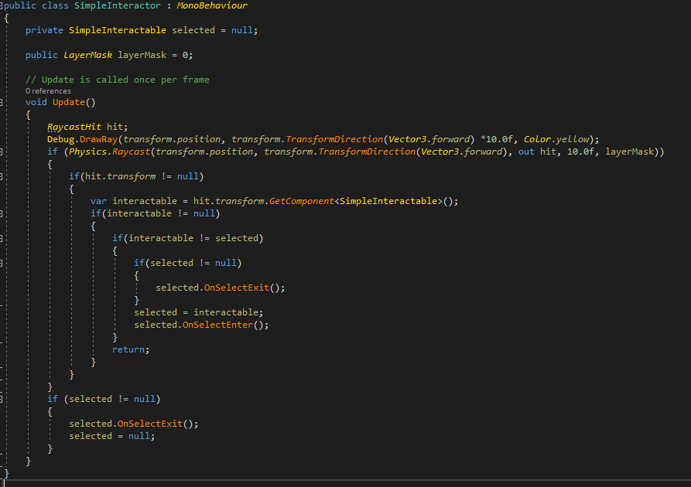
Code!
Interactor Monobehaviour

Slide 21
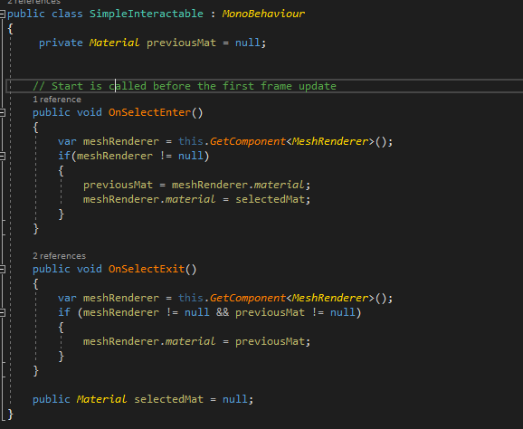
Code!
Interactable Monobehaviour

Slide 22
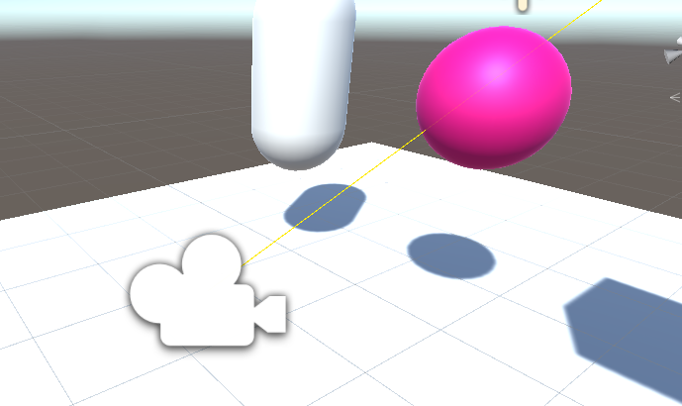
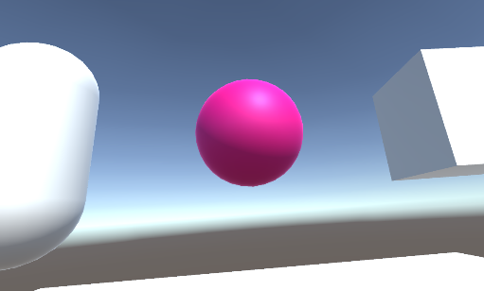
A FEW THINGS TO NOTE
Debug lines only render in the “Scene” window in the editor.
All objects we can interact with are marked with the XR Interaction Layer
Relatively simple, but not very robust example.

Slide 23
A slightly more robust approach
The interactor shoots a ray along its forward normal
All the things that the ray hits that are interactable objects are asked if we can select them by the interaction manager
The interactable objects that are ok with being selected by our interactor are marked as being selected by the interaction manager. (you can have multiple interactors all selecting the same objects)
If the trigger (or other interaction method) is pressed
The interaction manager asks the nearest interactable object if it is ok with being interacted with.
If so the interactable is now interacting with the interactor.

Slide 24
Interaction
Many different approaches to interacting with objects in your scene.
Separate the concept of “selection” from “interaction” (and potentially “hover” from “selection”)
Selectors should be simple, only concerned with identifying objects the user may wish to interact with
Interactable objects contain the logic on how they can be interacted with
Makes the system simpler, and far easier to extend.
An authoritative arbitrator (Interaction Manager) handles all decisions regarding what can be interacted with
Will allow extension into shared, networked experiences as long as there is only one authoritative node.

Slide 25
Interaction
Lots of different approaches to interacting physically with objects
Internal XR Interaction toolkit uses velocity matching for non kinematic objects.
Look at the code for VRTK/MRTK to see what other libraries are doing.
Different objects will likely need different anchor points
You hold a sword differently to a wand.
Interactable objects are usually made up of smaller sections
Can add complications if you want different interactions on different parts of a game object (eg: reloading a gun, compared to firing one)

Slide 26
Throwing and smoothing
Controllers always have some amount of latency
Humans typically have a pull back when throwing
It helps to have variable weighting for previous frames when determining throw direction / velocity
Weight the last few frames way less than the preceding ones that have motion in the intended direction
You can average rotation by extracting the rotation around the motion of the controller and averaging that over your sample period.

Slide 27
Locomotion
Lots of different ways to move a user in VR
Lots of different ways to make people really motion sick in VR too.
Lots of awesome research on ways to keep people comfortable during locomotion
https://developer.oculus.com/blog/research-into-comfortable-locomotion/
https://docs.microsoft.com/en-us/windows/mixed-reality/comfort
https://www.blog.google/products/daydream/daydream-labs-locomotion-vr/

Slide 28
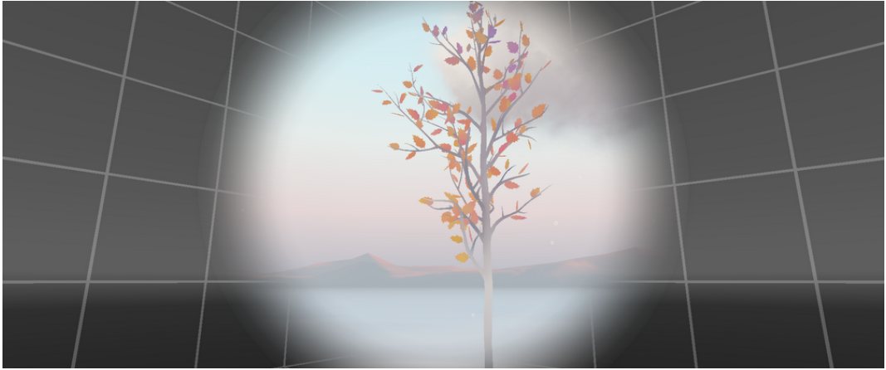
locomotion comfort
Periphery gives consistent reference frame
Center contains moving image of world during locomotion
https://www.blog.google/products/daydream/daydream-labs-locomotion-vr/

Slide 29
Teleportation
An extension on existing themes we’ve covered so far.
General Gist
Shoot a raycast into the scene
If it hits something we can teleport to, and the user is pressing the teleport button
Move the XR Rig for the user to that location.
The Location will be determined on what type teleportation destination the user has selected.
Typically two types of destinations
A surface that the user can teleport to wherever they select on it. (Surface)
A predetermined teleportation destination (Anchor) when the user selects a surface.

Slide 30
Teleportation
Various ways to stop users teleporting through walls or to undesired locations.
If no Teleport Surface MonoBehaviour on raycast result, disable teleporting
Can mark surfaces up with a different LayerMask to indicate surfaces that are impassable.
Always a good idea to indicate to the user if teleportation is available
If you’re using a controller model, you want to put it on a different layer to the selectable objects you can teleport to!
May want to fade the screen to black, and fade back in to mask the teleportation for user comfort.

Slide 31
A Quick implementation
Important points from code walk through
Use Raycast Hit.point to get the raycast impact point.
You’ll need some way to communicate this point to the interactable objects you’re interacting with
I did this with a simple extended interface on the interactor class.
You’ll need some way to communicate input
We can cheat because l/r hands do the same thing, but this will take some thought if you’re juggling lots of interaction!
Don’t forget to debounce button presses!
I only did this on the rotation, but you can easily “break” things with the teleport
Don’t forget which buttons are buttons, and which are axis!
Trigger reports an axis value for example. GetButton wont work!

Slide 32
Curved teleporter Rays?
Couple of different ways to do this
Simplest is to use a series of sequential raycast segments to approximate the curvature you desire.
Interesting approach using a biezier curve and a separate raycast position from Oculus
https://developer.oculus.com/blog/teleport-curves-with-the-gear-vr-controller/
Would be interesting to play with using the vertical angle of the controller to control the height of the raycast position.

Slide 33
Quick Best practices
You want your physics update and your frame rate to be the same for the best “feeling” interaction
VR is very frame rate sensitive, learn how to use the profiler and the debug tools to ensure that you do not drop frames under any circumstances
I/O is always going to be tricky
Get blocking work off the main thread
Pre-load as much as possible!
Try and generate as little garbage as possible to avoid GC stalls.
Look into Physics.RaycastNonAlloc
Use structs over classes for items you create a lot of (stack vs heap)
Make sure you use the most optimal graphics options available
Single pass / Instanced will give a significant frame boost over Multipass
Not available on all hardware, check with Nat!

Slide 34
Links

